Slide 1
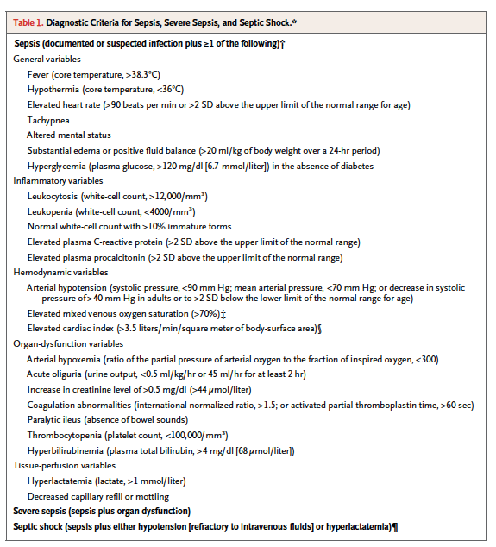

Slide 2
SELECT h.subject_ID,
h.hadm_id
FROM mimic2v26.admissions h,
mimic2v26.ICD9 code
WHERE code.SUBJECT_ID = h.SUBJECT_ID
and ( substr( code.CODE , 1 , 3 ) in (
'001' -- Cholera;
, '002' --Typhoid/paratyphoid fever;
, '003' --Other salmonella infection;
, '004' --Shigellosis;
, '005' --Other foodpoisoning;
, '008' --Intestinal infection nototherwise classi�ed;
, '009' -- Ill-de�ned intestinal infection;
, '010' --Primary tuberculosis infection;
, '011' --Pulmonary tuberculosis;
, '012' --Other respiratory tuberculosis;
, '013' --Central nervous system tuberculosis;
, '014' --Intestinal tuberculosis;
, '015' --Tuberculosis of bone or joint;
, '016' --Genitourinary tuberculosis;
, '017' --Tuberculosisnot otherwise classi�ed;
, '018' --Miliary tuberculosis;
, '020' --Plague;
, '021' --Tularemia;
, '022' --Anthrax;
, '023' --Brucellosis;
, '024' --Glorers;
, '025' --Melioidosis;
, '026' --Rat-bite fever;
, '027' --Other bacterial zoonoses;
, '030' --Leprosy;
, '031' --Other mycobacterial disease;
, '032' --Diphtheria;
, '033' --Whooping cough;
, '034' --Streptococcal throat/scarlet fever;
, '035' --Erysipelas;
, '036' --Meningococcal infection;
, '037' --Tetanus;
, '038' --Septicemia;
, '039' --Actinomycotic infections;
, '040' --Other bacterial diseases;
, '041' --Bacterial infectionin other diseases not otherwise speci�ed;
, '

Slide 3
'325' --Phlebitis of intracranial sinus;
, '420' --Acutepericarditis;
, '421' --Acute or subacute endocarditis;
, '451' --Thrombophlebitis;
, '461' --Acute sinusitis;
, '462' --Acute pharyngitis;
, '463' -- Acute tonsillitis;
, '464' --Acute laryngitis/tracheitis;
, '465' --Acute upper respiratory infection of multiple sites/not otherwisespeci�e d ;
, '481' -- P n e umo c o c c a lpneumonia;
, '482' --Other bacterial pneumonia;
, '485' --Bronchopneumonia with organism not otherwise speci�ed;
, '486' --Pneumonia organism not otherwisespeci�ed;
, '494' --Bronchiectasis;
, '510' --Empyema;
, '513' --Lung/mediastinum abscess;
, '540' --Acuteappendicitis;
, '541' --Appendicitis not otherwise speci�ed;
, '542' --Other appendicitis;
, '566' --Anal or rectal abscess;
, '567' --Peritonitis;
, '590' --Kidney infection;
, '597' --Urethritis/urethral syndrome;
, '601' --Prostatic in�ammation;
, '614' --Female pelvic in�ammation disease;
, '615' --Uterine in-�ammatory disease;
, '616' --Other femalegenital in�ammation;
, '681' --Cellulitis �nger/toe;
, '682' --Other cellulitis or abscess;
, '683' --Acute lymphadenitis;
, '686' --Other local skin infection;
, '730' --Osteomyelitis;
)
or substr( code.CODE , 1, 6) in (
'491.21' -- Acute exacerbation ofobstructive chronic bronchitis;
, '562.01' -- Diverticulitis of small intestinewithout hemorrhage;
, '562.03' --Diverticulitis of small intestine with hemorrhage;
, '562.11' --Diverticulitis of colon withouthemorrhage;
, '562.13' --Diverticulitis of colon with hemorrhage;
, '569.83' -- Perforation ofintestine;
)
or substr( code.CODE , 1, 5) in (
'569.5' -- Intestinal abscess;
, '572.0' --Abscess of liver;
, '572.1' --Portal pyemia;
, '575.0' --Acute cholecystitis;
, '599.0' --Urinary tractinfection not otherwise speci�ed;
, '711.0' --Pyogenic arthritis;
, '790.7' --Bacteremia;
, '996.6' --Infection or in�ammation ofdevice/graft;
, '998.5' --Postoperative infection;
, '999.3' --Infectious complication ofmedical care not otherwise classi�ed.
)
)
090' --Congenital syphilis;
, '091' --Earlysymptomatic syphilis;
, '092' --Early syphilislatent;
, '093' --Cardiovascular syphilis;
, '094' --Neurosyphilis;
, '095' --Other late symptomatic syphilis;
, '096' --Late syphilis latent;
, '097' --Other and unspeci�ed syphilis;
, '098' --Gonococcal infections;
, '100' --Leptospirosis;
, '101' --Vincent�s angina;
, '102' --Yaws;
, '103' --Pinta;
, '104' --Other spirochetal infection;
, '110' -- Dermatophytosis;
, '111' --Dermatomycosis not otherwise classi�ed or speci�ed;
, '112' -- Coridiasis;
, '114' --Coccidioidomycosis;
, '115' -- Histoplasmosis;
, '116' --Blastomycotic infection;
, '117' --Other mycoses;
, '118' --Opportunistic mycoses;
, '320' --Bacterialmeningitis;
, '322' --Meningitis unspeci�ed;
, '324' --Central nervous system abscess;

Slide 4
TEMPERATURE (678) > 101 ou <96.8
HEART RATE (220045 /220048 /211 heartrate [value1num]) > 90 BPM
RESPIRATORY RATE ( 618 ou 614 ou 615 ou 618ou /651 ou 1151ou 1884ou 3603 ou3337) > 20 /min
GCS (198) < 12
WEIGHT Localisation ???? Volume perfuse > 20 ml/kg J1
GLUCOSE ( 811 ou 1529 ) > 120 mg/dl IF absence de diabete (250 ou 648)

Slide 5
WBC (1542 ou 1127 ou 861 ou 4200) > 12000 / mm3 ou <4000/mm3

